Slide 1
TRANSIENT STRUCTURAL SIMULATION
USING ANSYS WORKBENCH

Slide 2
SIMULATION CONDITIONS
LOADING CONDITIONS
Constraints:
Fixed Support on one face.
Load:
Force
Location:
Five Different Faces of Hexagon.
Magnitude:
Based on DOB=2032N
Material
Custom material named “abc”.
Youngs Modulus (E)=3000Mpa.
Poisson Ratio=0.28.
Geometry
Hexagonal Beam
Length=20metres.

Slide 3
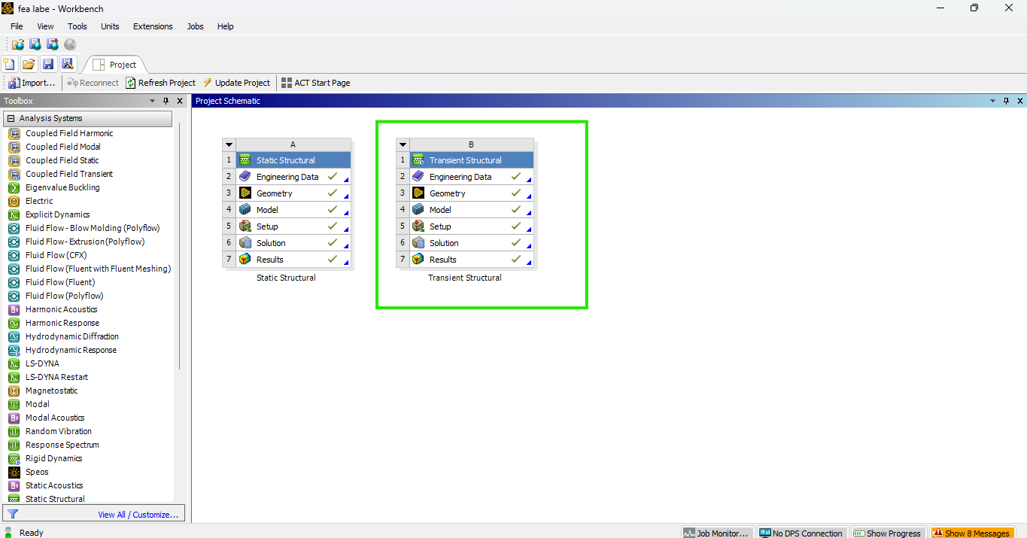
Open Workbench → Create New Project → Drag Transient Structural into Workspace

Slide 4
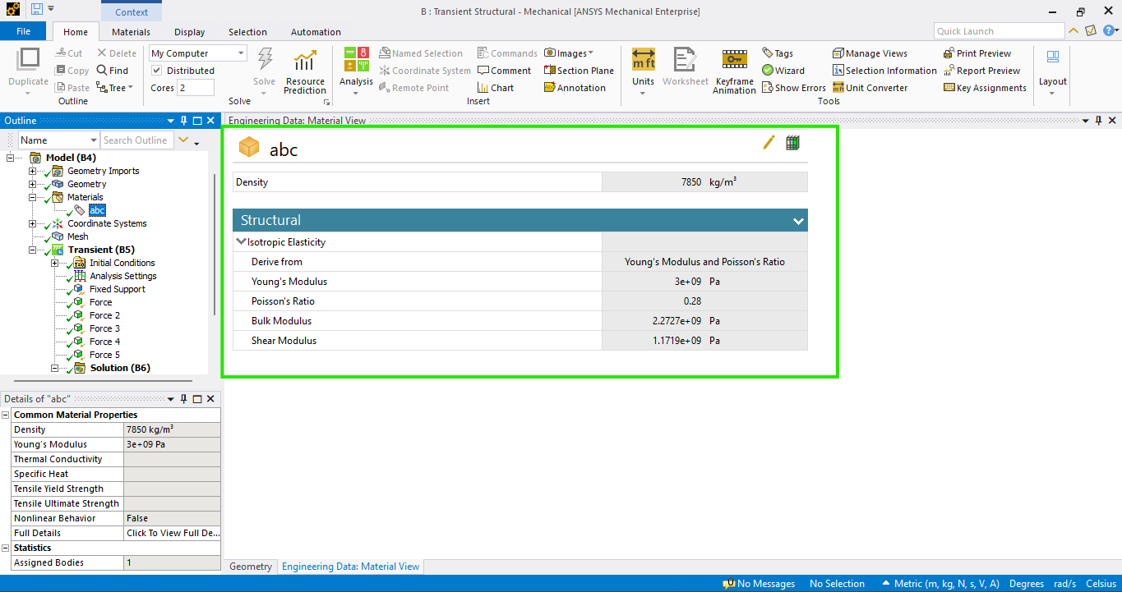
Add Custom Material “abc” in Engineering Data (define E=3000 MPa, ν=0.28, ρ=7850 kg/m³, delete Structural Steel)

Slide 5
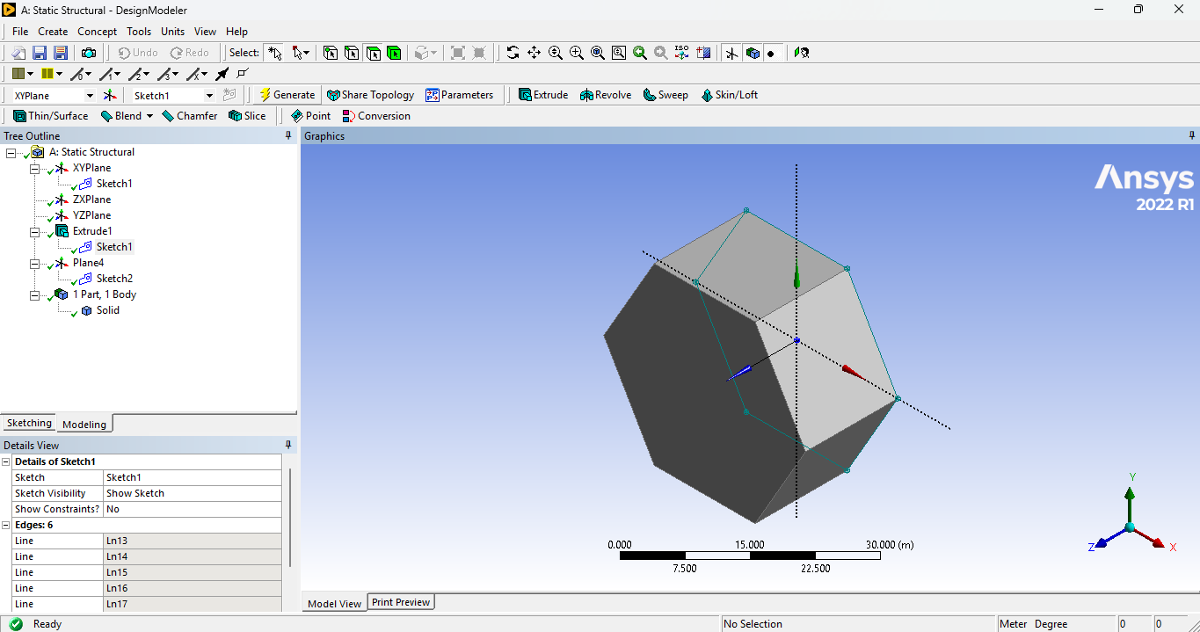
Open Design Modeler → Sketch Hexagon → Extrude → Set Length = 20 m

Slide 6
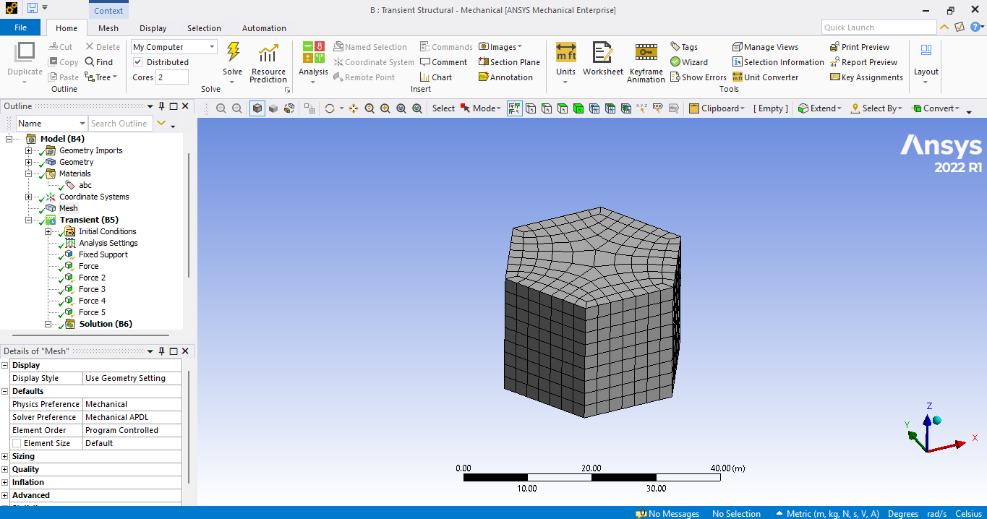
Open Mechanical → Generate Mesh → Apply Sizing / Choose Mesh Type (tet or hex) if needed

Slide 7
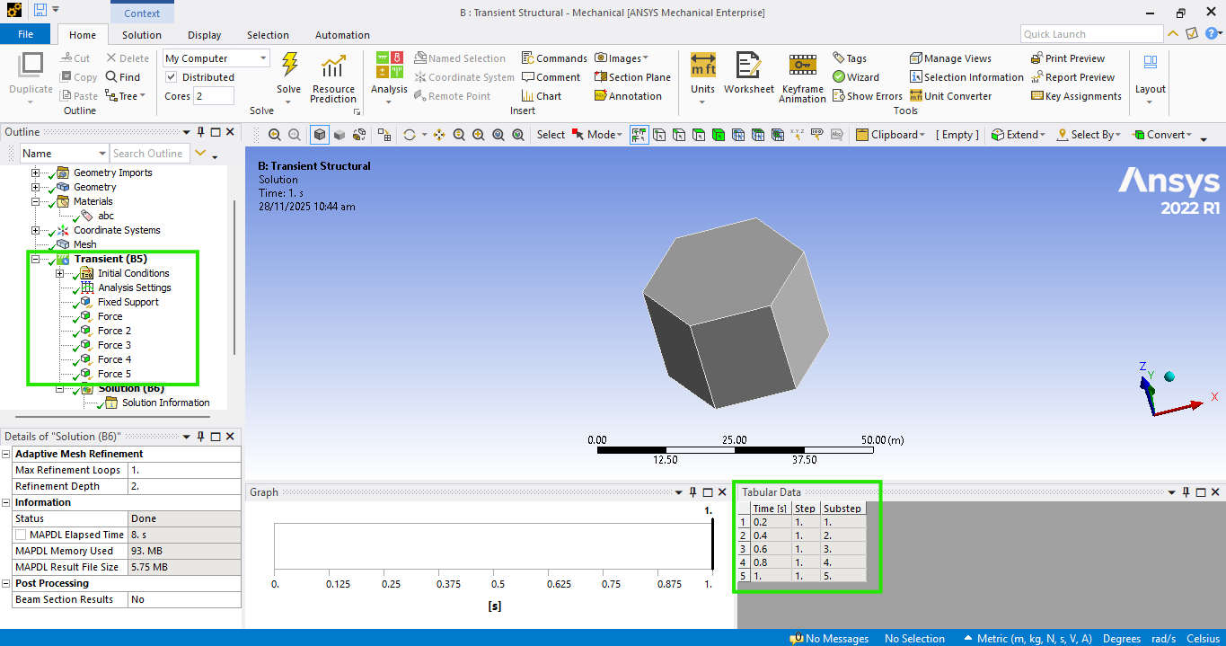
Apply Fixed Support at Bottom → Apply Forces on 5 Faces with 0.2 s Steps up to 1 s

Slide 8
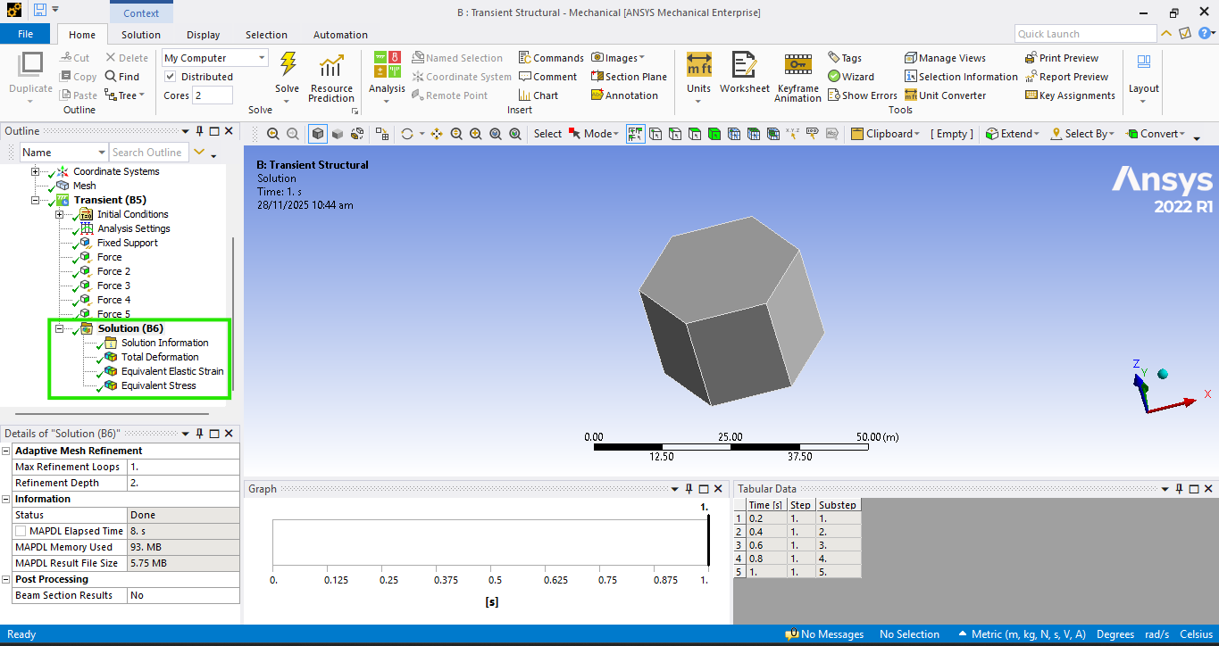
Select Total Deformation, Equivalent Stress & Strain → Solve to Compute Results

Slide 9
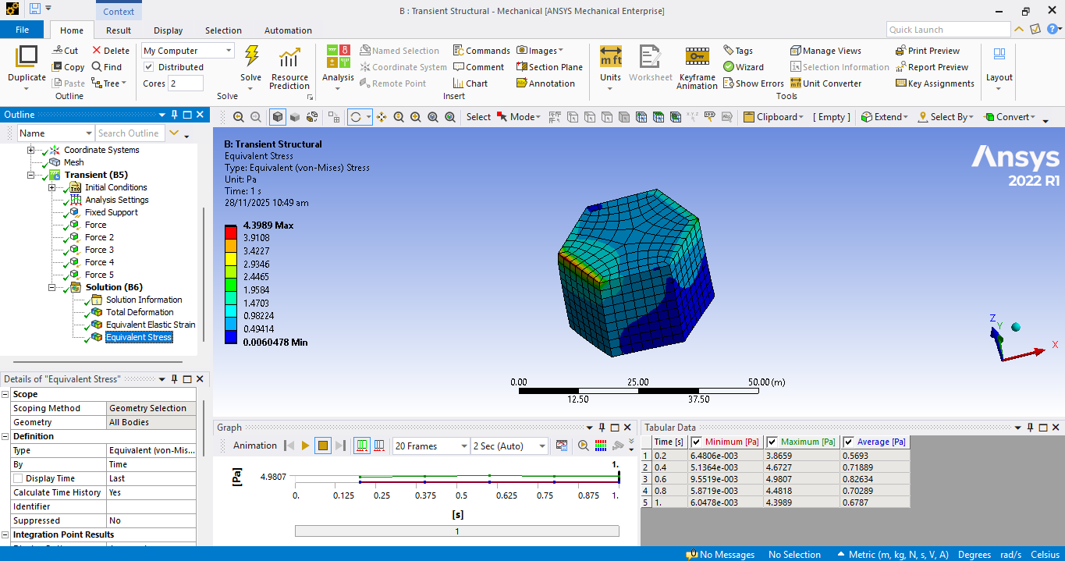
Solve the Analysis → View All Results in the Solution Section

Slide 10
THANK YOU

